Slide 1
Podcast Engine
~By Vikram Chourasiya

Slide 2
Podcast Engine Project Abstract:
The goal of Podcast engine is to provide converting PDF. So, a fundamental requirement of this project is to know everything about books. The other goal is to provide the experience of podcast.

Slide 3
Objective of Podcast Engine:
To explore varieties of books, form different publishers, writers.
To classify them on basis of public review and their quality no matter which language or budget.
To have extremely good reading experience for users.
To listen in two different voices.

Slide 4
System Description:
This is an application-based system where users can find two option that how to convert PDF. The application has a special setting in which it has four themes for more user experience. Application has a text box where users can write their own data to be converted.

Slide 5
Process Model:
The waterfall model of development has been taken into consideration while developing this project. Every step for updating or improving as this model ensures smooth flow of project development.

Slide 6
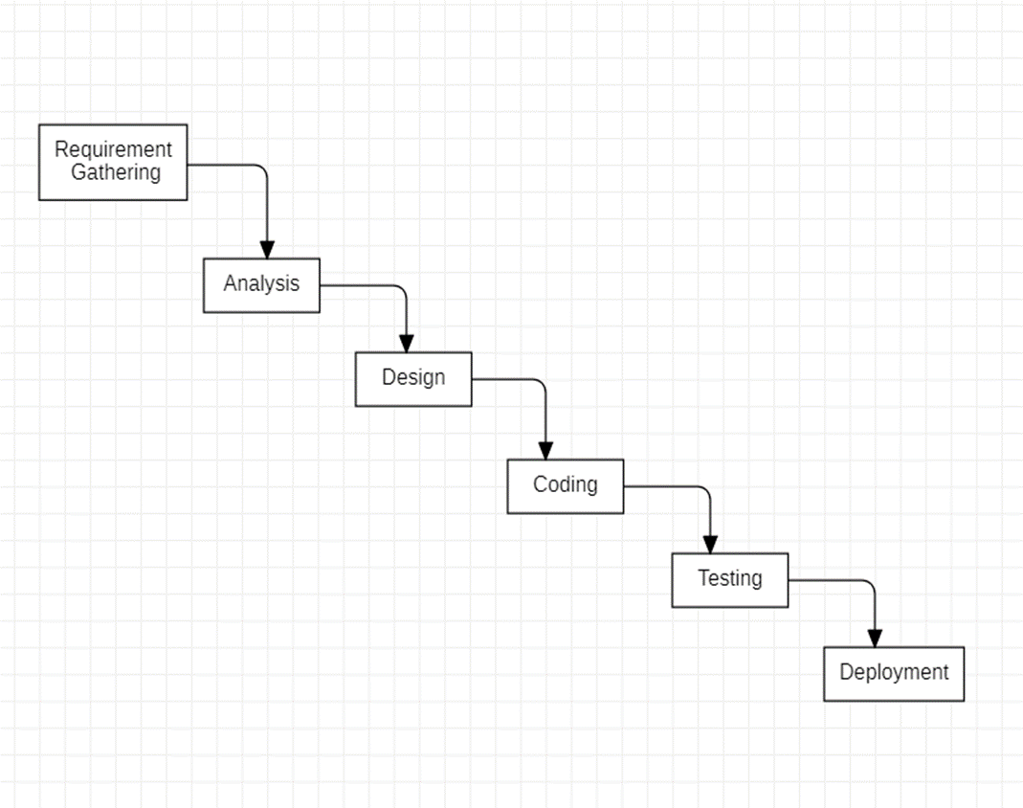

Slide 7
Working Of Podcast Engine Activity Diagram:
Activity diagrams are graphical representations of workflows of stepwise activities and actions with iteration and concurrency. Activity diagrams can be used to describe the business and operational step-by-step workflows of components in a system. An activity diagram shows the overall flow of processes.

Slide 8
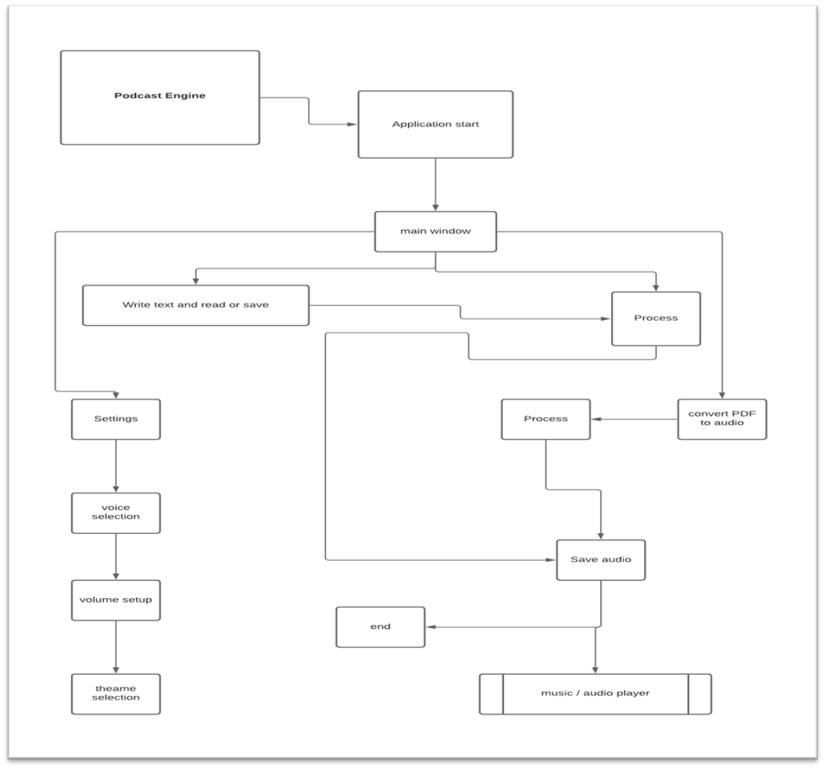

Slide 9
System Requirement:
OS Requirements
Windows
Linux
Android
Software Requirements
Pip Install & packages
Python 3
Visual Studio Code

Slide 10
Hardware Requirement:
Processor:
1.0 GHz or Greater
Ram:
2GB or Greater.

Slide 11
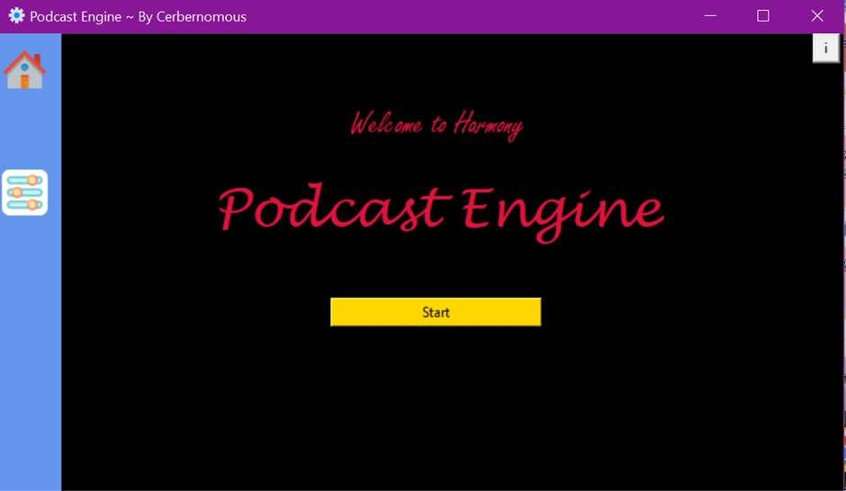
First Page:

Slide 12
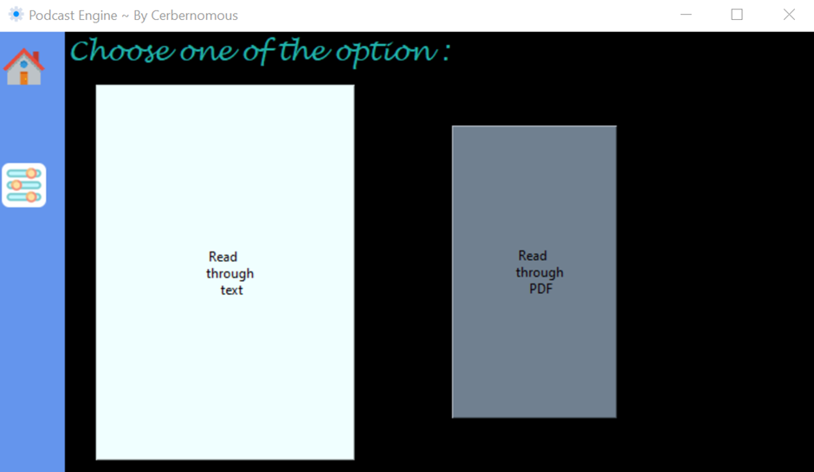
Start-Up Page:

Slide 13
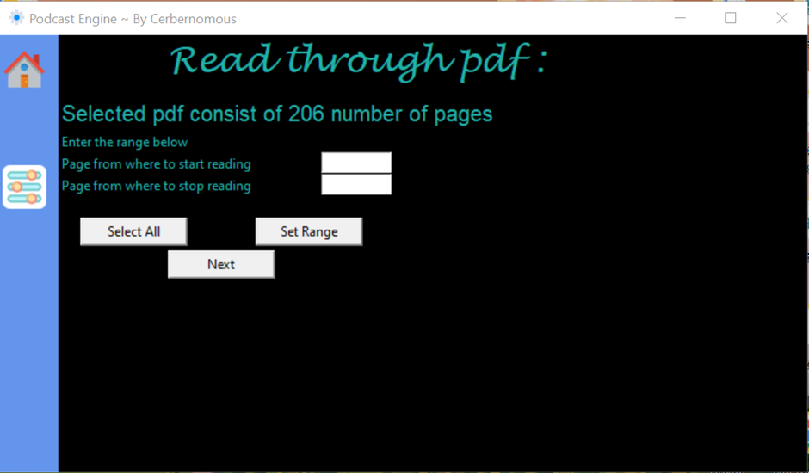
Play-Control:

Slide 14
Thank You

